Slide 1
MM215 –Experiment-3
Data acquisition
DAC
ADC
Sampling and reconstruction

Slide 2
Learning
Analog vs digital world
Digitization of an analog quantity
Digital to analog converter
Analog to digital converter
Sampling of data (and sampling theorem)
The MM215 training kit
Recap

Slide 3
Analog vs Digital

Slide 4
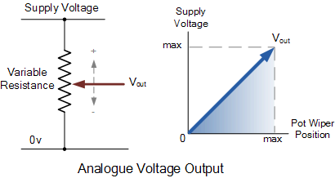
Analog Signals
Analog signals – directly measurable quantities in terms of some other quantity

Slide 5
Analog Signals
Analog signals – directly measurable quantities in terms of some other quantity
Examples:
Thermometer – mercury height rises as temperature rises
Car Speedometer – Needle moves farther right as you accelerate
Level – Level in a tank increases as water is filled in it

Slide 6
Digital Signals
Digital Signals – have only two states.
For example, in digital computers, we refer to binary states, 0 and 1.
“1” can be ON, and “0” can be OFF.
Examples:
Light switch can be either on or off
Door to a room is either open or closed
Answer to an objective type problem can be either ‘true’ or ‘false’

Slide 7
Analog → Digital Conversion 2-Step Process:
Quantizing: Breaking down analog value in a set of finite states
Encoding : Assigning a digital word or number to each state and matching it to the input signal

Slide 8
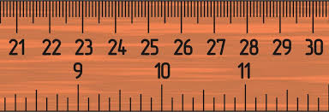
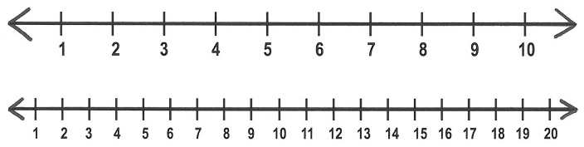
Discrete world
9.5
9.675
Number line

Slide 9
Discretization
Range divided in steps
Steps: m x 10^{n} or 2^{n}
e.g. 2x10³ = 2000
Or 2¹¹ = 2048
Any value within the range is represented by its index
e.g. for a range 0-2000
RANGE
500,
1000,
1500,
2000
Discretization by guessing (approximation)

Slide 10
Discretization
Characteristic properties of discretization
Range
Number of steps
Representation (Decimal vs binary)
Speed of conversion?
Linearity
Monotonicity
Noise
Conversion function
Analog
Digital

Slide 11
Successive approximation
V
1 1
10
01
00
3V/4
Value to be estimated
V/2
V/4
0
Guess
2
Guesses
Digital representation
… (2 bit s. Can have only 4 values)
1
Value low
1
H
2
L
1 0
Value high
Take a range (domain) divided into 4 discrete steps

Slide 12
Successive approximation (8 steps)
V
7V/8
6V/8
Value to be estimated
5V/8
V/2
3V/4
V/4
V/8
0
1
0
1

Slide 13
Approximations for an 3 bit ADC
V
111
110
101
100
011
010
001
000
7V/8
6V/8
5V/8
V/2
3V/4
V/4
Value to be estimated
V/8
0
0
0
1

Slide 14
Successive approximation ADC
Next guess
DAC produces the guessed voltage
SAR
DAC
Clock
+
Makes a guess
-
High/low
Comparator
Unknown voltage
Compares DAC output with the unknown voltage

Slide 15
Digital to analog conversion
Converse problem
Given
Encoded value (e.g. binary code)
Range (e.g. 0 to 5V)
Convert to equivalent analog value
Is based on summing property of an opamp
X b³
X b²
∑
1 0 1 0
Equivalent analog value
X b⁰
X b¹
b³ b² b¹ b⁰

Slide 16
Digital to Analog Converter (DAC)
+V
+V
+V
4mA
2mA
1mA
1000Ω
1
1
0
I_{F}
I_{F}
0
0
0
0
1
1
1
0
0
1
1
0
0
1
0
1
0
1
0
1
1
2
0
1
3
4
5
6
7
-
c b a I_{F}
0V
V_{OUT}
+
0 0 0 0mA
0 0 1 1mA
0 1 0 2mA
0 1 1 3mA
1 0 0 4mA
0 1 5mA
1 1 0 6mA
1 1 1 7mA
0V
Take an op amp having –ve feedback
Provide multiple inputs in the manner of a summing amplifier.
The inputs supply current wighted as 2^{n}
I_{F} = (a2⁰+b2¹+c2²)
V_{OUT} = (a2⁰+b2¹+c2²)
x1000
3 bit DAC

Slide 17
Resolution in digital measurements
ADC resolution (1 in 2^{n} steps)
No of bits | Total steps | Resolution (%)
8 | 256 | 0.39%
10 | 1024 | 0.1%
12 | 4096 | 0.024%
16 | 65536 | 0.0015%
18 | 262144 | 3.8ppm
20 | 1048576 | 0.95ppm
Bathroom scale ,200Kg 0.1kg resolution
Grocery scale, 20kg, 1g resolution
Lab scale, 100g , 1mg resolution
High res. lab scale, 10g, 1μg resolution
2¹¹
Weigh scale
application:
1 in 2000
1 in 20000
1 in 100000
1 in 10million
2¹⁵
2¹⁷
2²⁰

Slide 18
Resolution in digital measurements
ADC resolution (1 in 10^{n} steps)
No of digits | Total steps | Resolution (%)
3 | 999 | 0.1%
3½ | 1999 | 0.05%
4 | 9999 | 0.01%
4½ | 19999 | 0.005%
6 | 999999 | 1ppm
6½ | 1999999 | 0.5ppm
Weigh scale
application:
Bathroom scale ,200Kg 0.1kg resolution
Grocery scale, 20kg, 1g resolution
Lab scale, 100g , 1mg resolution
High res. lab scale, 20g, 1μg resolution
3½
1 in 2000
1 in 20000
1 in 100000
1 in 20million
4½
5
6½

Slide 19
Analog to digital converter (ADC)
Range ∝ (V_{ref})
Analog input
ADC
D₀
Start conversion
D₁
Converted digital output on a bus
D₂
D₃
Clock
End of conversion
D_{n}
Read converted value

Slide 20
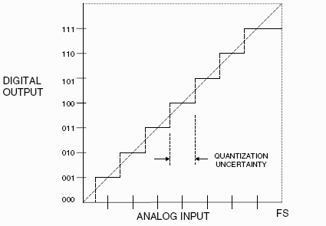
Discretization – ADC transfer function
Non linearity

Slide 21
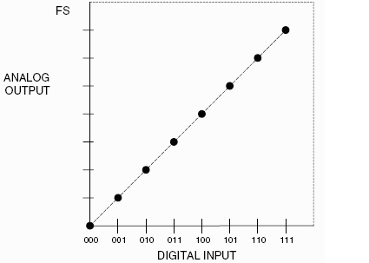
Discretization – DAC transfer function

Slide 22
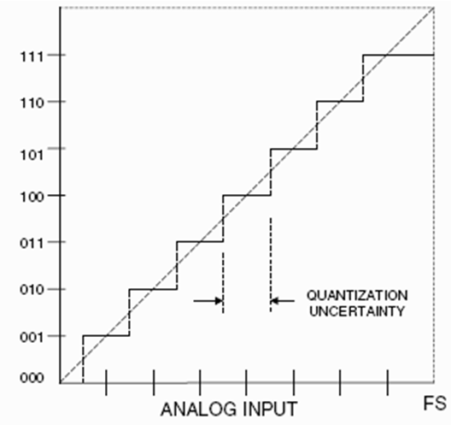
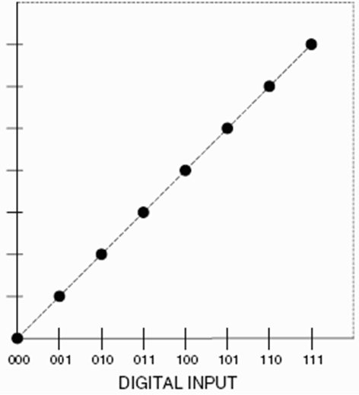
Quantization errors during discretization

Slide 23
Accuracy of A/D Conversion
Typical usage of ADC involves: convert to digital → digital processing → convert back to analog
Inaccuracies during conversions is the chief problem
There are two ways to best improve accuracy of A/D conversion:
increasing the resolution which improves the accuracy in measuring the amplitude of the analog signal.
increasing the sampling rate which increases the maximum frequency that can be measured.

Slide 24
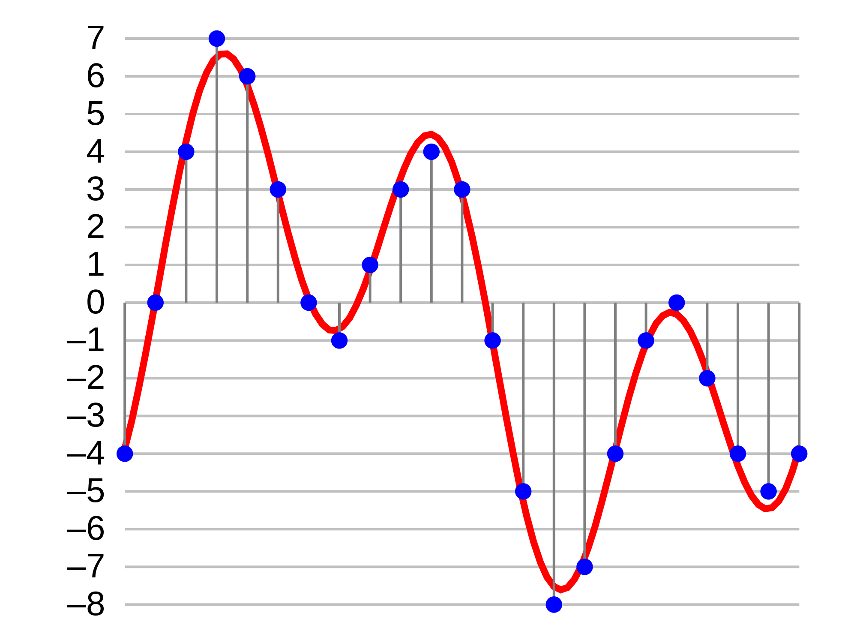
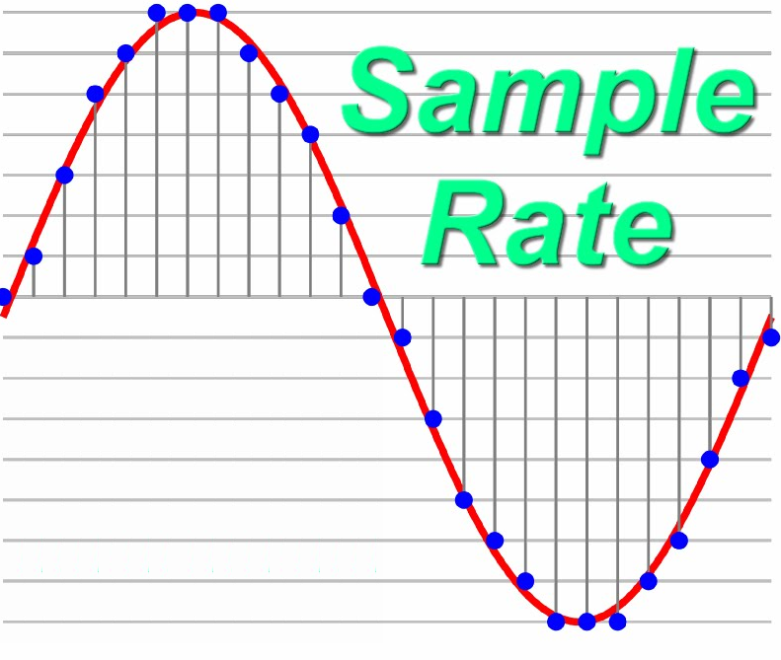
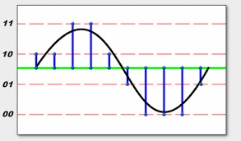
Sampling of data
Effect of ADC resolution

Slide 25
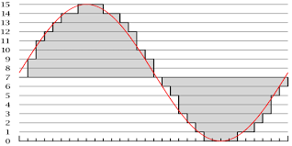
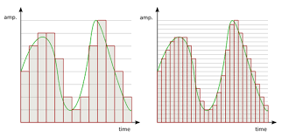
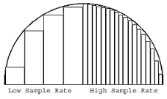
Effect of sampling rate

Slide 26
Sampling Rate
Frequency at which ADC evaluates analog signal. As we see in the second picture, evaluating the signal more depicts the ADC signal ore accurately

Slide 27
Overall Better Accuracy
Increasing both the sampling rate and the resolution you can obtain better accuracy in your AD signals.

Slide 28
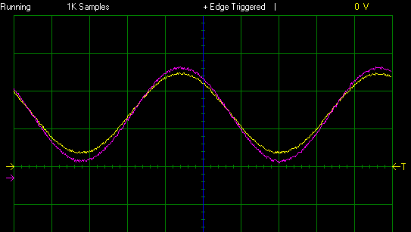
ADC Input and Reconstructed Waveforms (4 Hz)

Slide 29
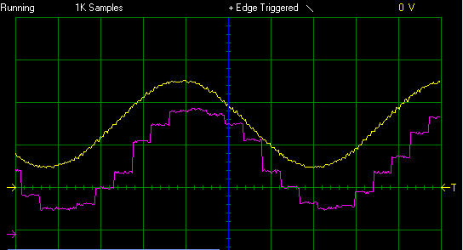
ADC Input and Reconstructed Waveforms (80 Hz)

Slide 30
Introduction to the MM215 kit
Trainer kit provides
DAC, ADC and interconnection facility
Temperature sensors
Heater
Voltage amplifiers to interface sensors
Microprocessor (actually a Microcontroller)
Computer interface

Slide 31
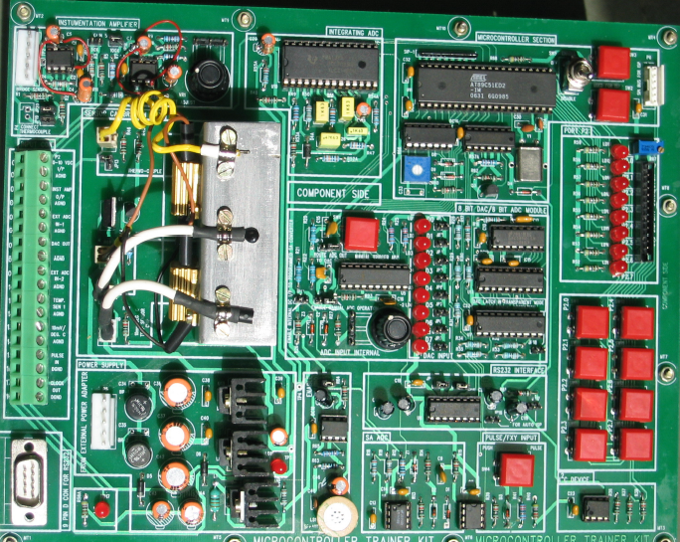
MM215 kit

Slide 32
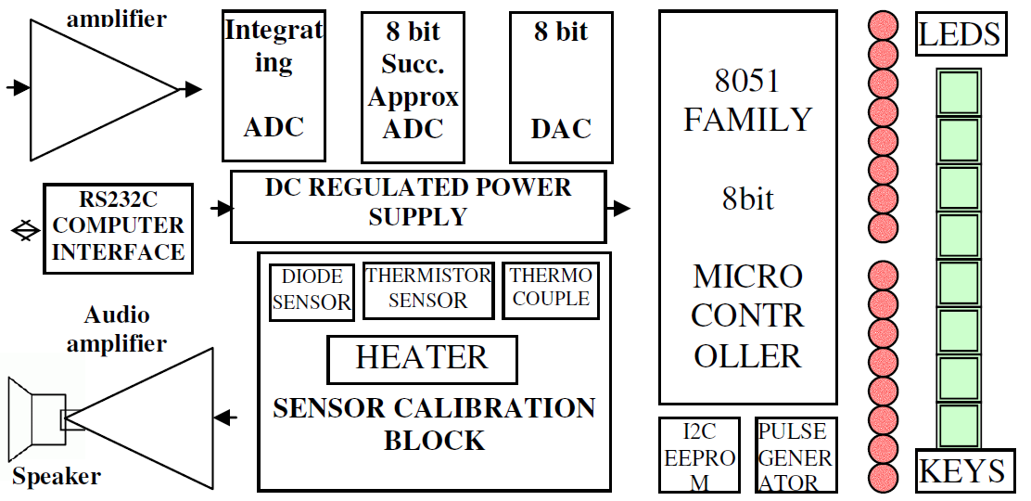
MM215 Kit

Slide 33
IC215 kit
IC215 Kit is designed for use in modes
Standalone use of resources (μC is not used)
All resources used along with μC
In experiment-3 we use the kit in standalone mode
Experment-3 has 3 parts
Part A: Learning to use the DAC
Part B: Learning to use the ADC
Part C: Using both ADC/DAC for sampling and reconstruction of AC waveform

Slide 34
Using IC211 Kit
Stand-alone mode (without the Microcontroller)
Done by moving the ENABLE CPU switch in the DISABLE mode
• Functional blocks which can be used in stand-alone mode
– ADC and DAC sections
– Temperature sensor section
– Audio amplifier section
– Instrumentation amplifier section

Slide 35
Onboard ADC 0804
Popular chip from National instruments
8-bit, successive approximation type (~0.4%)
Input voltage range : 0 to 5 V
Specified by reference voltage = V_{Range}/2
Clock frequency : 1.2 MHz (max)
Conversion time : < 100 μs

Slide 36
DAC
• DAC 0800: High speed 8-bit current output DAC
• Settling output current : 100ns
• Full-scale error : +/- 1 LSB
• Output full scale current: 2 mA
• Current output can be converted into a voltage by putting a resistor or by using a I-V converter.
• voltage range : up to 10 V (typical)

Slide 37
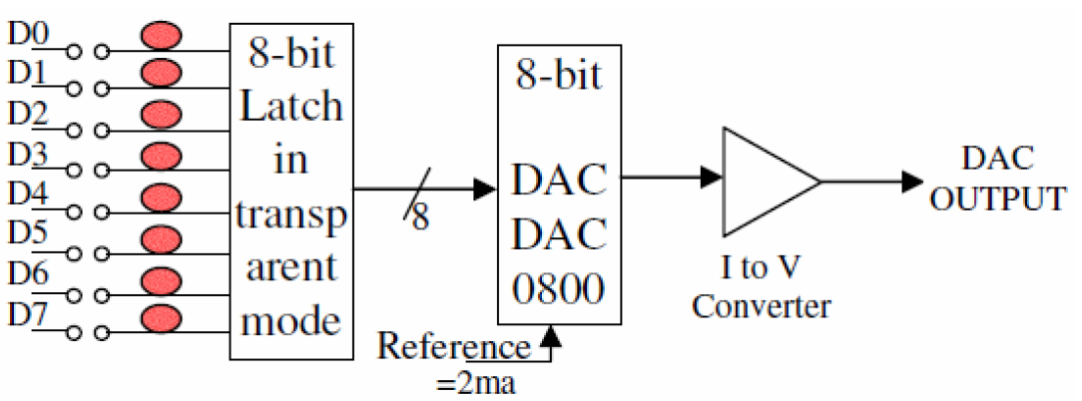
DAC Section

Slide 38
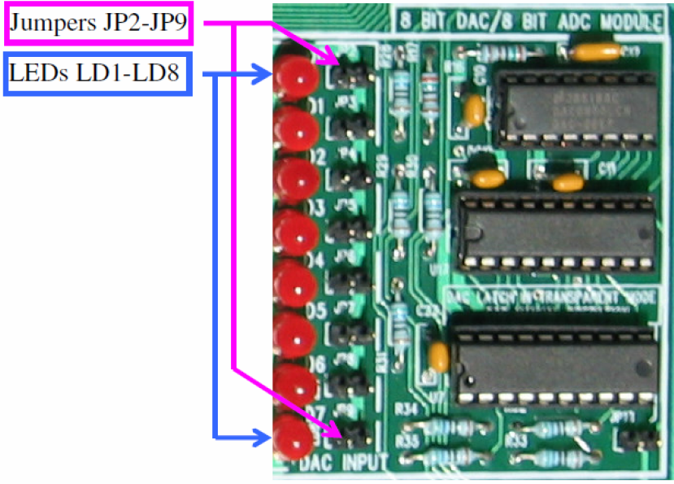
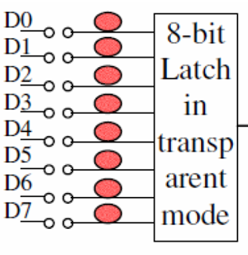
DAC Section

Slide 39
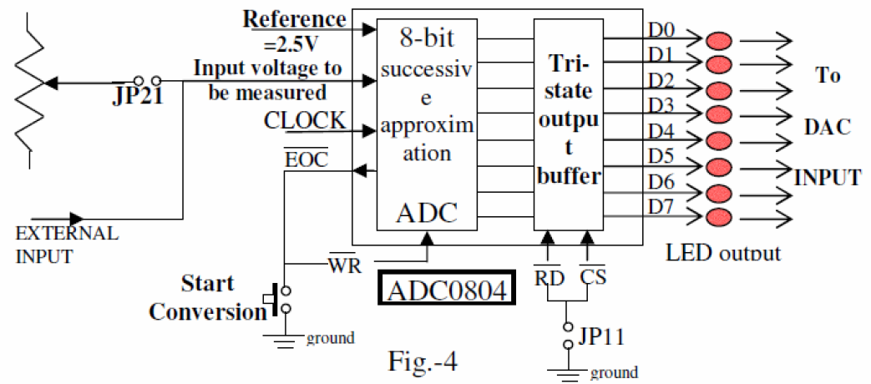
ADC schematic

Slide 40
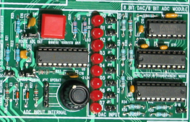
ADC and DAC
LED and Jumpers
ADC
DAC

Slide 41
Experiment: Part A DAC
Monitoring DAC output voltage using a Digital Multimeter
Jumpers JP2 to JP9 (putting any jumper makes that particular bit 0)
Put all jumpers (JP2 to JP9) - corresponds to 00000000 (binary); note the reading
Remove jumpers one by one and note the reading
All jumpers removed - (corresponds to 11111111 (binary) – full scale reading

Slide 42
Experiment: Part B ADC - with internal DC input
ADC input options
Either internal DC through a potentiometer (0 to 5 V) – Jumpers JP11 and JP21 inserted.
OR
External Analog input (through the connector) from a signal source

Slide 43
Part B: ADC with internal DC
Put jumpers JP11 and JP21 (JP11 routes ADC output to DAC inputs; JP21 is for enabling internal ADC input)
Remove jumpers J2 to J9 (DAC inputs) so as to observe ADC output through DAC
Keep potentiometer fully CCW initially,
Rotate pot clockwise – observe DAC LEDs and measure corresponding ADC input voltage

Slide 44
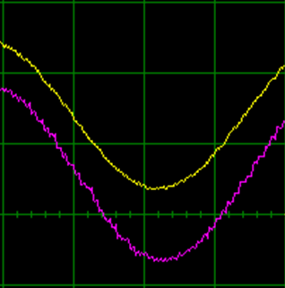
Part C : Signal Digitization and Reconstruction
ADC
DAC
From signal generator
Digitized
Reconstructed
Scope trace

Slide 45
Part C : Signal Digitization and Reconstruction
Remove JP21 (to have ADC input from outside).
Keep JP11 (ADC outputs routed to DAC inputs)
Adjust Function generator in PC Scope to give sine wave with 2 Vpk-to-pk, and 1.5V DC offset, i.e signal going from 0.5 to 2.5 V
ADC input: external Sinusoidal signal (frequency= 10 Hz, from Function generator output)
Observe ADC input and DAC output(reconstructed waveform) on the USB Scope.
Increase frequency of sine wave and observe the reconstructed waveform.

Slide 46
Part C : Signal Digitization and Reconstruction
Obtain screen captures of ADC input and the Reconstructed Signal (at the DAC output)
Enable display of ON screen Voltage and frequency display
Sample screens shown in subsequent slides-
ADC input (Channel A – Yellow)
DAC output (Channel B – Purple)

Slide 47
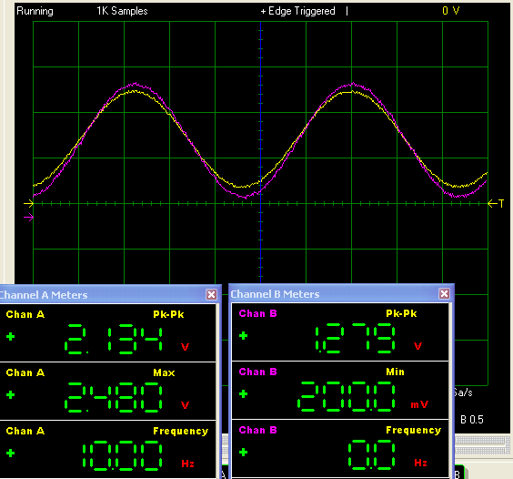
Displaying meters and signal on screen
Channel-A
Channel-B

Slide 48
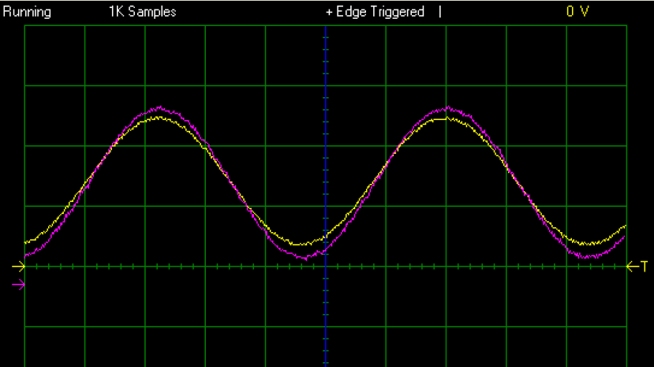
ADC Input and Reconstructed Waveforms (10 Hz)

Slide 49
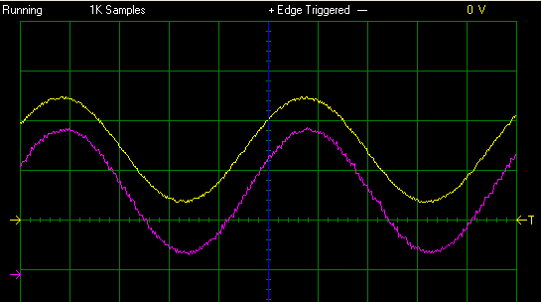
ADC Input and Reconstructed Waveforms (20 Hz)

Slide 50
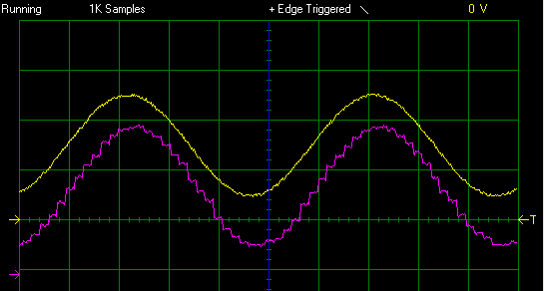
ADC Input and Reconstructed Waveforms (40 Hz)

Slide 51
ADC Input and Reconstructed Waveforms (79 Hz)

Slide 52
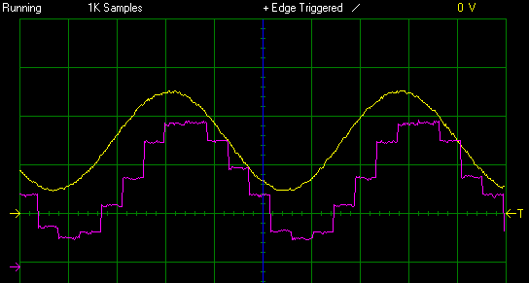
ADC Input and Reconstructed Waveforms (105 Hz)

Slide 53
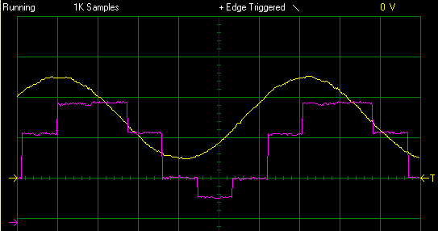
ADC Input and Reconstructed Waveforms (162 Hz)

Slide 54
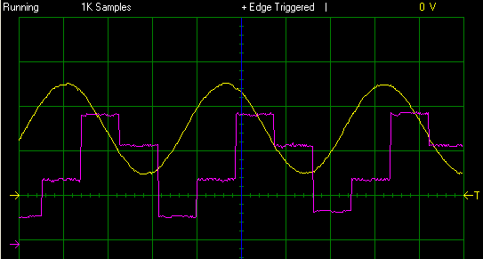
ADC Input and Reconstructed Waveforms (279 Hz)

Slide 55
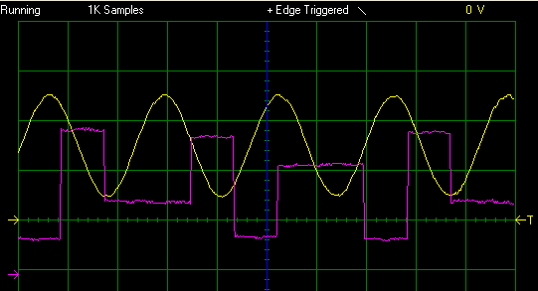
ADC Input and Reconstructed Waveforms (434 Hz)

Slide 56
See experiment-3 lab manual for more details

